Slide 1

Addressing Churn in GE’s Healthcare IT Service
A Data Analytic Solution
By Michael Surdek

Slide 2
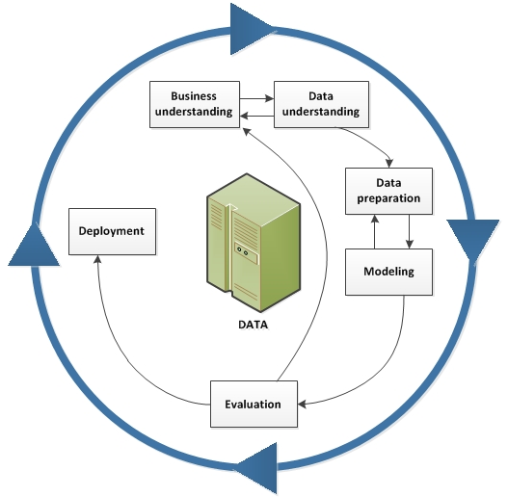
Agenda
CRISP-DM Phases
1. Business Understanding
2. Data Understanding
3. Data Preparation
4. Modeling
5. Evaluation
6. Deployment

Slide 3
Phase 1
Business Understanding
1. The Product
2. The Problem
3. Objectives
4. Tools & Techniques

Slide 4
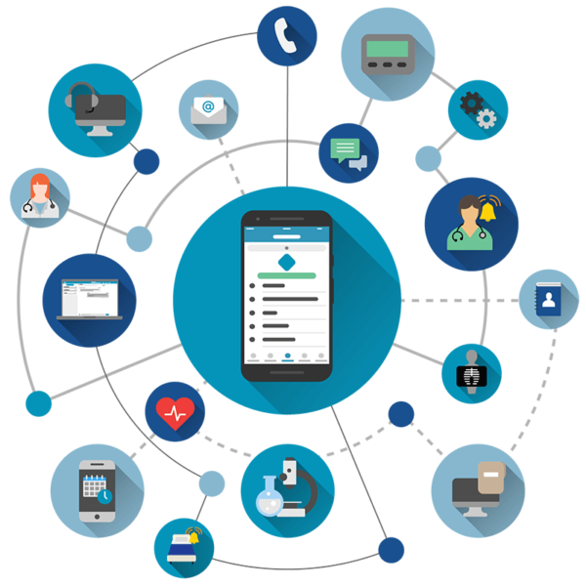
The Product
GE’s Healthcare IT application
- Assists medical professionals in their daily work
Customers are required to use:
- A GE-provided smartphone
- Coverage from their partner SmartAppCellular

Slide 5
The Problem
Recent increase in churn
Customer feedback indicates potential causes:
- Poor cellular coverage
- New vendors competing in the same space

Slide 6
Objectives
Data Mining Objective
- Use data mining and analytics to understand the causes of churn and predict which
customers are likely to churn
Business Operations Objective
- Modify business and marketing strategy to address and remediate the causes of churn
- Utilize churn predictions to proactively reach out to the customers who are at the highest
risk of churning

Slide 7
Tools & Techniques
Tools
R → programming language for statistical analysis and predictive modeling
Integration with current CRM platform for customer service & proactive outreach
Techniques
Binary classification
Logistic Regression Model
Predicts whether or not a customer is likely to churn
Notes:
GE’s offers a healthcare IT service product that assists medical professionals in their daily work. To ensure proper bandwidth and support, the application must be used with a GE-provided smartphone that only includes coverage from their partner, SmartAppCellular. The service is tendered on a subscription basis and lately GE has experienced an increase in attrition, or churn. Based on customer feedback, this recent churn is related more to the cellular coverage than to the application and the product itself. Additionally, GE recognizes that new vendors are beginning to compete with similar offerings, and that, if they wish to maintain or strengthen their position in the market, they need to identify and resolve the problems that are causing customers to cancel their subscriptions.

Slide 8
Phase 2
Data Understanding
1. Source Data Set
2. ID & Target
3. Personal
4. Usage
5. Subscription
6. Equipment
7. Customer Service

Slide 9
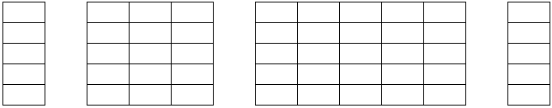
Source Data Set
Derived monthly from data warehouse
After preliminary cleaning and removing redundant variables, the sample data set contains 850 observations of 58 fields
17 Fields
Personal/Demographic
39 Fields
Usage/Subscription/Equipment
Target
Churned?
ID
Notes:
The data set that GE has compiled from their monthly reporting system is well suited for the purposes of building an analytical model to predict customers who are likely to churn. The sample data contains 1000 observations with 84 variables for each subscriber. There are approximately 30 fields that pertain to cellular coverage, equipment, and average usage patterns. The remaining fields include information on each individual such as family makeup, credit rating, occupation, and customer service history. Only 3 fields include categorical values, and the others are numeric, although some of these represent categories and are stored as binary numbers 1 and 0. In fact, 2 of the 3 categorical fields are labels for those binary variables just mentioned. Trial and error in the modeling phase can determine whether it is better to use the labels or the dichotomized values.

Slide 10
ID & Target Data
Unique Identifier – Customer ID
7 digits (e.g. 1000057)
No duplicates
Target – Churn
Whether or not a customer churned
1 = Yes / 0 = No
Sample data set
31% Yes
69% No

Slide 11
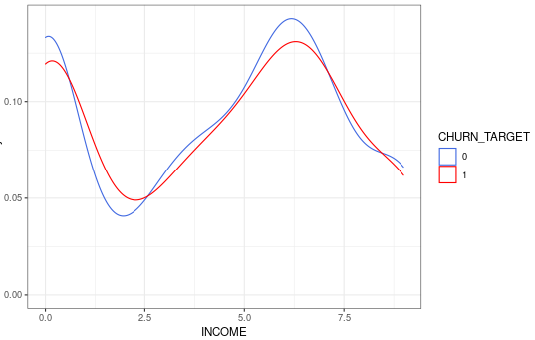
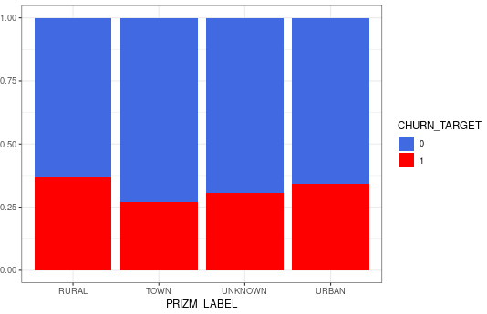
Personal Data
Numeric
Categorical
Binary
Income
Age (primary)
Age (secondary)
Credit adjustments
Credit rating
Location type
Area code
Occupation
Marital status
Home owner
Known traveler
PC owner
Credit card user
Children
Motorcycle
Truck
RV

Slide 12
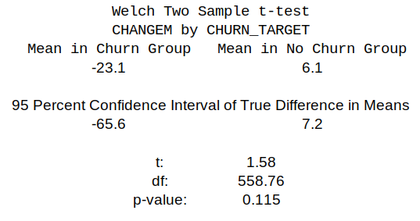
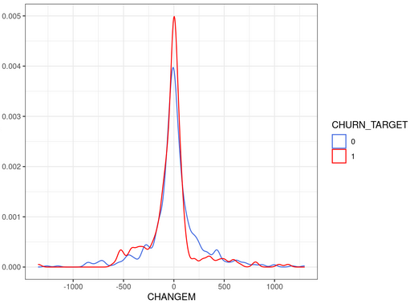
Usage Data
Numeric
Categorical
Binary
Minutes of use
Change in minutes
Director assisted calls
Dropped calls
Blocked calls
Dropped+Blocked calls
Unanswered calls
Call forwarding
Call waiting
Overage
Roaming
Customer care calls
Threeway calls
Minutes of received calls
Outgoing calls
Incoming calls
Peak voice calls
Off-peak voice calls

Slide 13
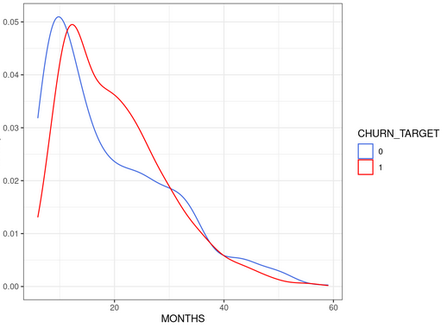
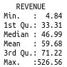
Subscription Data
Numeric
Categorical
Binary
Revenue
Change in revenue
Recurring charge
Months active
Active subscribers
Unique subscribers

Slide 14
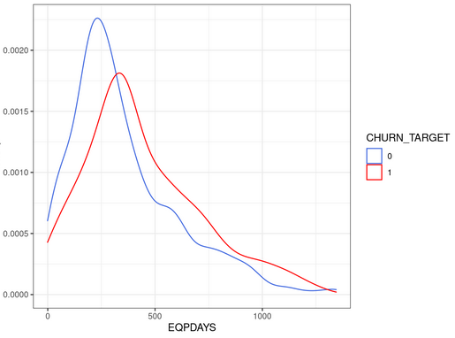
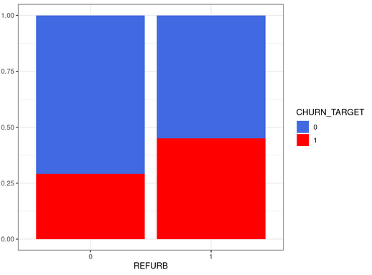
Equipment Data
Numeric
Categorical
Binary
Set price
Phones
Models
Equipment days
Refurbished
Web capability
New cell yes
New cell no

Slide 15
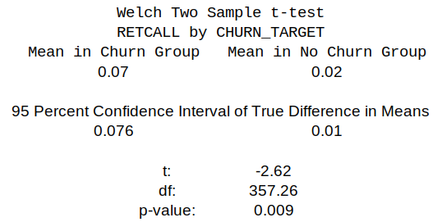
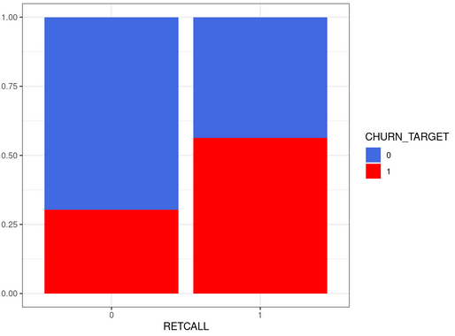
Customer Service Data
Numeric
Categorical
Binary
Referrals
Retention calls
Retention offers accepted
Retention call made
Orders by mail
Responds to mail
Unsubscribed from mail

Slide 16
Phase 3
Data Preparation
1. Reading/Cleaning Data
2. Handling Missing Values
3. Dimensionality Reduction
4. Feature Engineering
- Usage/Subscription PCA
- Low Minutes
- Area Code → Region

Slide 17
Reading/Cleaning Data
Step 1 - Read source data from .csv file
Step 2 - Rename ‘Column 45’ to ‘PRZM_NUM’
Step 3 - Create factor and integer fields from CHURN
Step 4 - Create categorical fields for marital status, occupation, and location type (PRZM)
Step 5 - Drop redundant columns

Slide 18
Handling Missing Values
Fill with median of non-null values
REVENUE
MOU
RECCHRGE
DIRECTAS
OVERAGE
ROAM
Fill with median of non-zero values
AGE1
AGE2
INCOME
SETPRC
Fill with zero
CHANGEM
CHANGER

Slide 19
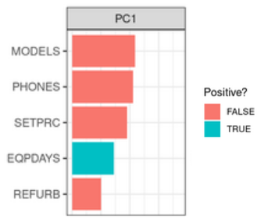
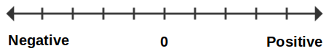
Dimensionality Reduction
Principal Component Analysis (PCA)
Combines information from multiple variables into a single value
Can quantify differences between types of customers and their experiences
The combined information may be a better predictor of churn than any of the attributes individually
Expensive, refurbished phones with recent/multiple replacements
One or few good, cheap phones that have lasted a long time

Slide 20
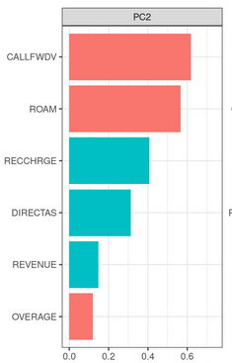
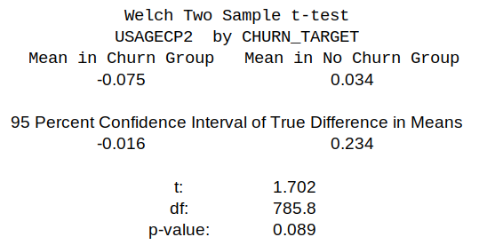
Feature Engineering
Usage/Subscription PCA
Describes the relationship between a customer’s base recurring charge, their usage such as roaming and overage, and their overall monthly cost
Customers with a negative value for this principal component are incurring fees that cause their low recurring charge to balloon into a higher monthly cost, and are more likely to churn

Slide 21
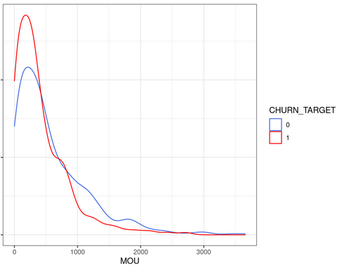
Feature Engineering
Low Minutes
Customers with few monthly minutes are more likely to churn
Derived Attribute:
Monthly minutes below 220
This binary factor is a better predictor than minutes alone because it is a strong signal to the model that the customer is likely to churn

Slide 22
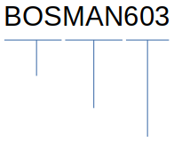
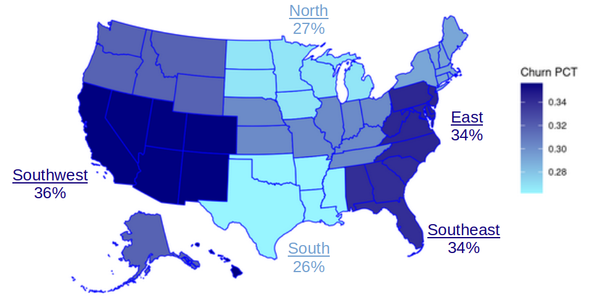
Feature Engineering
Area Code → Region
Communications Services Area (CSA)
- Encodes the customer’s area code, city, and major metropolitan area
- Enables derived attributes such as State and Region of the US
Metropolitan
Area
City
Area
Code

Slide 23
Phase 4
Modeling
1. Feature Selection
2. Upsampling
3. Regularization
4. Logistic Regression

Slide 24
Feature Selection
& Association with Churn (+/-)
Source Data Inputs
Change in minutes (-)
Retention call made (+)
Location type – Town (-)
Known traveler (-)
Children (-)
Derived Inputs
Usage Principal Component (-)
Low minutes (+)
Region East, SE, or SW (+)
Region North or South (-)
Credit rating DE or GY (-)

Slide 25

Upsampling
- Technique to handle imbalanced target data in predictive modeling
- With only 31% of customers churning in the source data, the model would be very
reluctant to predict that anyone is likely to churn
- Upsampling duplicates randomly selected observations of the minority class so that the
ratio of churn and no churn is closer to a 50/50 split
- The final proportion in the training data set of this model is 44% churn / 56% no churn

Slide 26
Regularization
- Technique to improve the generalizability of the model and prevent overfitting
- Standard logistic regression formulas simply minimize log loss, or the difference between
the actual observations and the likelihoods that it predicts
- Regularization adds a term that penalizes complexity in addition to inaccuracy
- Two Regularization Strategies
Ridge → drives coefficients towards zero
Lasso → sets less-important coefficients to zero
- Optimal split of ridge/lasso regularization determined by cross-validation

Slide 27
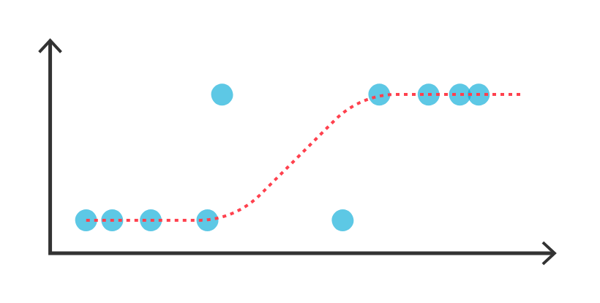
Logistic Regression
Formula
CHURN_TARGET ~ CHANGEM + RETCALL + PRIZMTWN + TRAVEL + CHILDREN + USAGEPC2 + MOU_low + CSA_region_SEW + CSA_region_NS + CREDITDEGY

Slide 28
Phase 5
Evaluation
1. Correlation & Collinearity
2. Model Results
3. Performance
4. Expectations

Slide 29
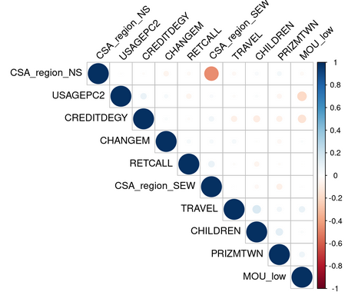
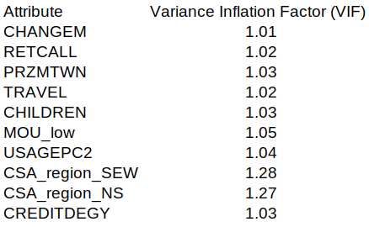
Correlation & Collinearity
Correlation Matrix Collinearity

Slide 30
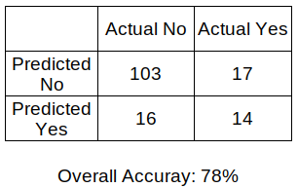
Model Results
Testing data
- 150 new customers
- 120 (80%) No
- 30 (20%) Yes

Slide 31
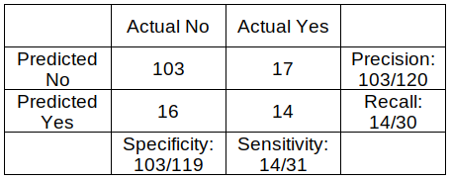
Performance
True Positive Rate (Sensitivity)
45%
Positive Predictive Power (Recall)
46%
True Negative Rate (Specificity)
87%
Negative Predictive Power (Precision)
86%

Slide 32
Expectations
- With randomly guessing customers that will churn, the following results would be expected:
- Overall accuracy → 80%
- Specificity & Precision → 80%
- Sensitivity & Recall → 20%
- With this model, the 2% decrease in overall accuracy is well worth the significantly
improved ability to predict both customers that will and will not churn
- Going forward into production, it can reasonably be expected that the model will predict
customers that churn with approximately 70% accuracy and that positive predictions
will be accurate around 40% of the time

Slide 33
Phase 6
Deployment
1. Model Output
2. Customer Retention Team
3. Estimated Value
4. Future Opportunities

Slide 34
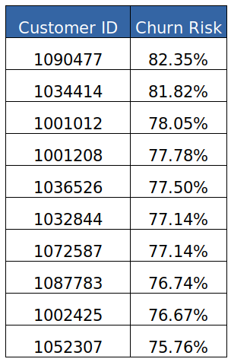
Model Output
- For each customer, the model provides both the chances
that they will churn and not churn, as well as a binary yes or
no prediction
- Based on the business needs and the customer retention
team’s bandwidth, this output can be based on the most
at-risk customers or anyone above a certain threshold

Slide 35
Customer Retention Team
- The customer retention can incorporate predictions from the model directly into their day-
to-day operations
- The model and it’s results will be integrated into their Customer Relationship Management
Software
- The model can be run weekly, scoring each customer and generating a list of customers
for the team to proactively contact
- Based on the number of customers that can realistically be contacted in any week, the list
can be limited to those most likely to churn, or it can be any customer that the model
believes is likely to churn above a certain threshold, e.g. 50%
- offering resoultions to their problems or potential discounts with the hope of saving their business and recurring revenue

Slide 36
Estimated Value
Assumptions:
Subscriber base = 50,000
Proportion likely to churn = 20% (10,000 of 50,000)
Proportion identifiable = 40% (4,000 of 10,000)
Proportion savable = 25% (1,000 of 4,000)
Average monthly revenue = $60
Full implementation may save $60,000 of recurring monthly revenue

Slide 37
Future Opportunities
1) Addressing the causes of churn
- Why are customers from the coasts cancelling more? Poor cell service?
- How can we improve our equipment and avoid numerous replacements?
- Are we charging too much in overage and roaming fees​?
2) Expanding marketing towards people who are less likely to churn such as those who:
- live in the northern & central parts of the US
- reside in towns
- have children
- travel
3) Further improvements for customer retention team
- Alignment on identifying the optimal number of at-risk customers
- Rate all customers high, medium, or low risk of churn
- Provide risk rating and potential reasons for the rating each time someone is interacting with the customer

Slide 38
Conclusion

Slide 39
Fin

Slide 40
References

